Slide 1

Dhaka Emergency Power Distribution System
A DSA-Based Crisis Response to the 2026 Global Fuel Crisis
Built for Crisis. Powered by Logic.
Samiul Azim | Hasan Al Khabir | Nafis Dayan Proyas | Ahmed Abdullah Hamza
CSE207 — Data Structures | East West University, Dhaka

Slide 2
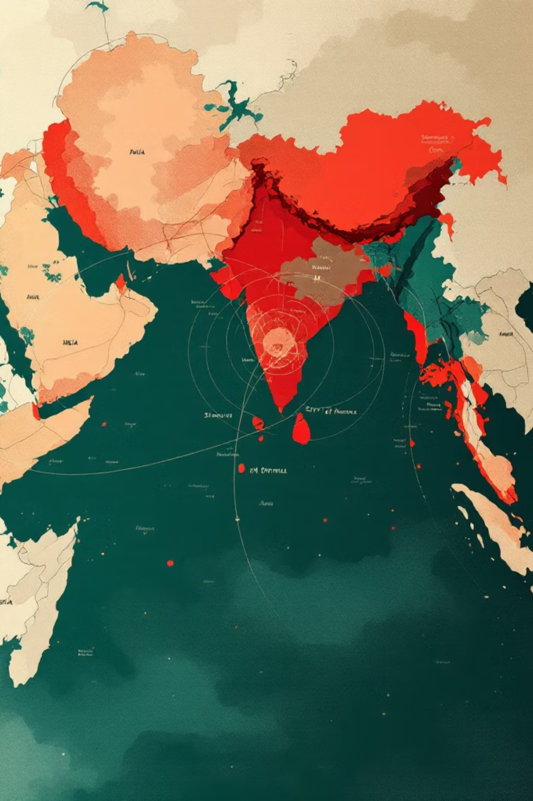
A World on the Brink — Bangladesh at the Center
Global Shock
National Risk
USA‑Israel‑Iran war → Iran closes the Strait of Hormuz
World Bank: Bangladesh critically at risk of fuel depletion
20% of global oil supply blocked overnight
Rolling blackouts across all divisions
Social Impact
Universities shut for 2 weeks to conserve fuel
When there isn't enough power for everyone — who gets it first?

Slide 3
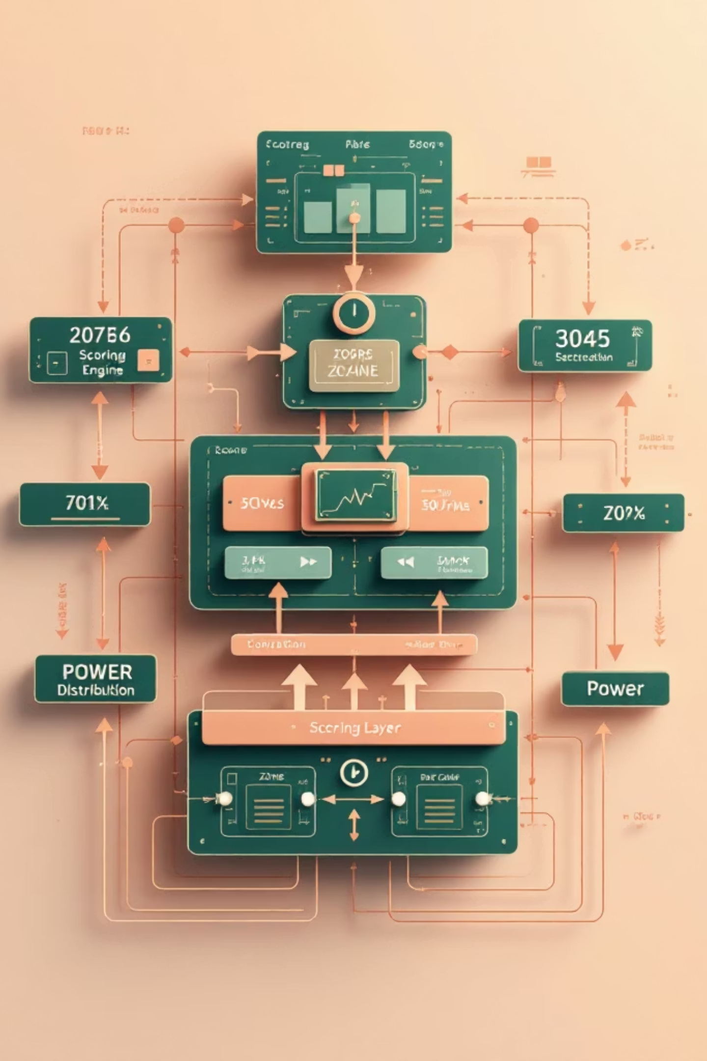
The Distribution Dilemma — Our Solution
The Problem
Our Solution
Manual distribution: slow, biased, dangerous
No automated crisis-time allocation
Hospitals ≠ offices under power loss
C app managing 8 Dhaka zones
Weighted scoring engine ranks zones
LIFO Stack: highest priority served next
Emergency Override → immediate Rank 1

Slide 4







Eight Zones & Priority Formula
Hospitals ×9
Industries ×6
Schools ×5
Banks ×4
Life‑critical (highest)
Economic survival
Future of the nation
Financial systems
Population ×4
Govt Offices ×3
Emergency Override
Human impact
Administrative continuity
+100 pts → instant Rank 1
Zone scores (examples): Old Dhaka 56 | Dhanmondi 62 | Motijheel 46 | Mirpur 24 | Uttara 33 | Mohammadpur 33 | Gulshan 45 | Tejgaon 38

Slide 5

DSA Foundation
Structs
Arrays
LIFO Stack
Zone = {name, facilities, status, score, rank}
zones[], stack[], waitingList[], logs[]
Top 3 unpowered zones; pop() to distribute; reverse-push to rebuild

Slide 6
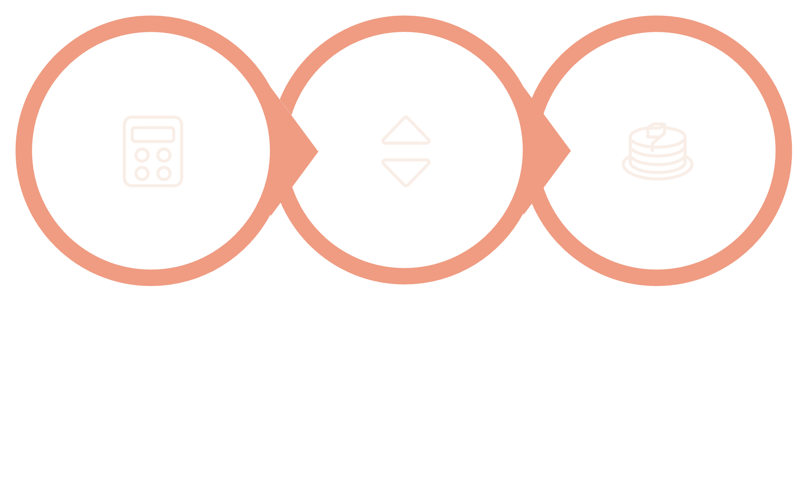



Recompute
Re-rank
Restack
System never stale — one facility change triggers full rebalance. Bubble Sort used for instant re-ranking.

Slide 7






Key Operator Features
Live Ranking
Give Power
View all 8 zones by priority
Power top-ranked zone (one action)
Emergency
Update Facilities
Override to Rank 1 instantly
Add/remove facilities → live updates
Top‑3 areas using Stack
Activity Log
View current stack contents
History of powered zones + full logs

Slide 8

Results, Limitations & Future
Test Results ✅
Limitations ⚠️
Correct ranking across all zones
Emergency override elevates instantly
Stack rebuild accurate after each distribution
Zero crashes in tests
Bubble Sort — not scalable beyond ~50 zones
Fixed arrays — max 10 zones
Console only — no GUI
Future Scope 🚀
Dynamic memory → unlimited zones | Merge Sort → scale to 64+ districts | GUI + cloud DB → remote multi-operator access

Slide 9

Conclusion — Code That Could Save Lives
Core
Principle
Structs + Arrays + Stack + Sorting = crisis-response system
When grid goes dark — hospital before office. People before paperwork.
Quote
"Fair distribution under pressure is not a management problem. It is a data structure problem."

